Slide 1

To Design and Deploy TCP based Multithreaded Chat Client Server
Name | Roll Number
Om Chakane | 10
Pranali Pardeshi | 15
Arshad Patel | 18
Pratiksha Patil | 28
Prashanth Bijamwar | 51
Prof.: VIRENDRA PAWAR.

Slide 2
Objectives
To design TCP based chat client-server system using multithreading in JAVA.
To learn JAVA.
To learn Threads, Sockets and Network Programming.

Slide 3

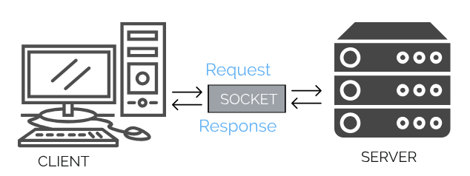
What is a Network?
->A computer network is a group of computers connected by some medium and share data between them as and when required.
The first and simple logic while transfer of data is that we require the address of the sender or receiver.
Java Network programming supports the concept of sockets.
A socket identifies the endpoint in a network.
However, the communication takes place through a protocol.
The Internet-Protocol is a lower level, connection less protocol for delivering data into small packets from one address to another. But, it does not guarantee to deliver the packets to destination.
The higher level protocols used with IP are TCP (Transmission Control Protocol) and UDP (User Datagram Protocol)

Slide 4
Implementation
We will be creating two major classes one for Server and one for Client.
They will be connected using Sockets (using java.net.Socket class available in java).
We want our program to support multiple clients at the same time, to make it possible we will be using threads to handle each request.

Slide 5
Client Server Model
A client and server networking model is a model in which computers such as servers provide the network services to the other computers such as clients to perform a user based tasks.
A server provides a service for many clients not just for a single client. Therefore, we can say that client-server follows the many-to-one relationship. Many clients can use the service of one server.
A client program runs only when it requests for a service from the server while the server program runs all time as it does not know when its service is required.

Slide 6
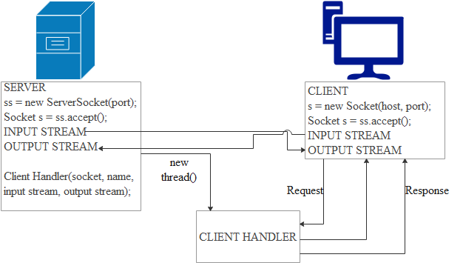
TCP Protocol
Java supports both TCP and UDP, however we are using TCP protocol in our project as transmission is lossless and reliable.
TCP makes connection between two addresses and exchange the stream of data, so it is also called Stream-based communication.

Slide 7
Conclusion
Centralized back-up is possible in client-server networks, i.e., all the data is stored in a server.
The use of the dedicated server increases the speed of sharing resources. This increases the performance of the overall system.
Large number of clients sending requests to the same server may cause the problem of Traffic congestion.
It does not have a robustness of a network, i.e., when the server is down, then the client requests cannot be met.

Slide 8
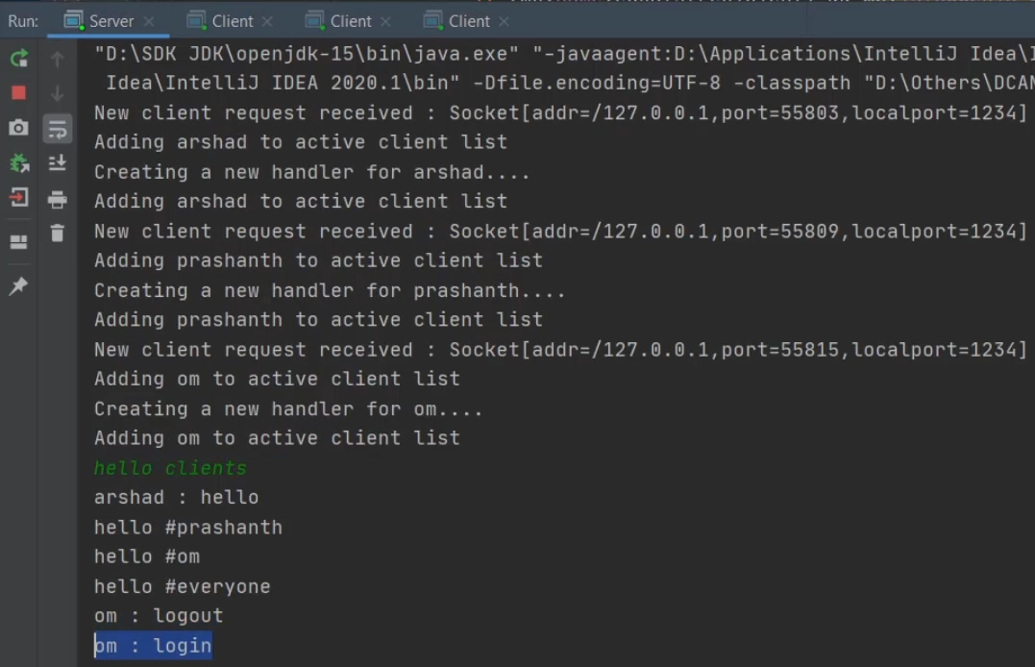
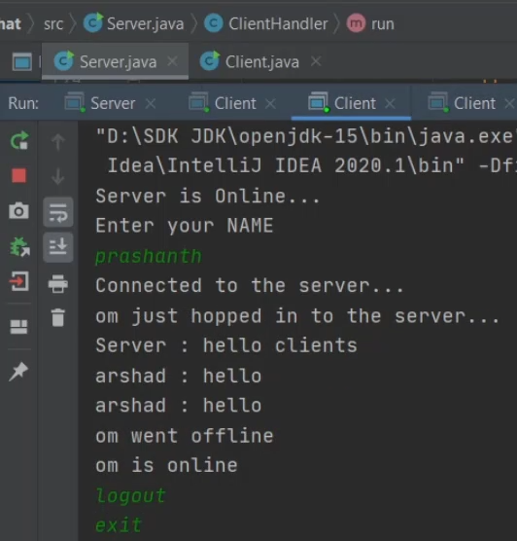
Output
SERVER
CLIENT

Slide 9
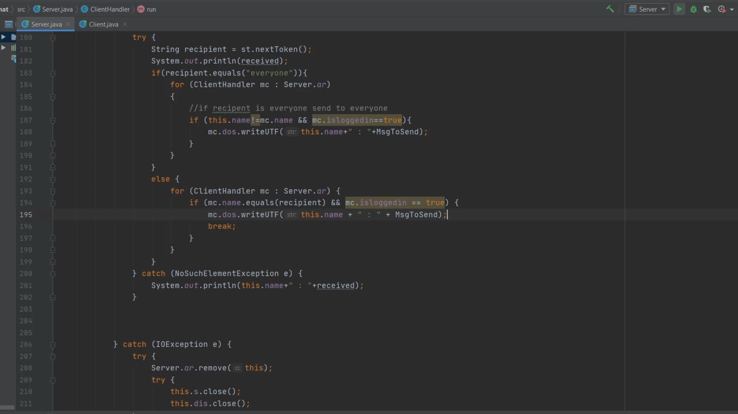

Slide 10
Thankyou

